Slide 1
Welcome!
¡Bienvenidos!

Slide 2
Agenda
Introductions
Project Review
Review Youth listening session data
Review staff survey responses
Update safe space kits for Pride
Next steps
Notes:
For Spanish Interpretation:
In your meeting/webinar controls, click Interpretation
Click the language that you would like to hear. We will track questions in the chat and reach out with any answers that we can’t answer immediately

Slide 3
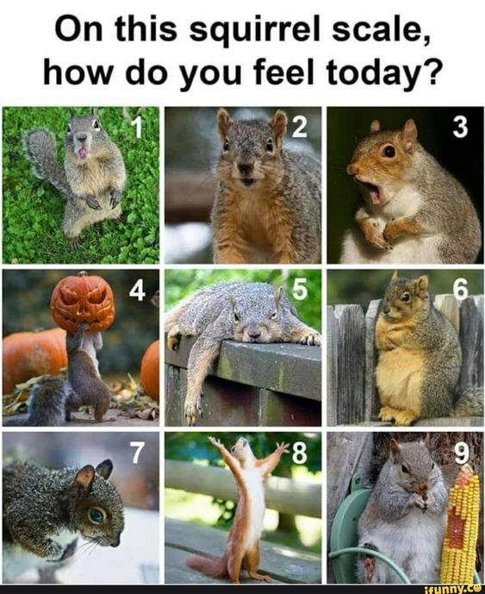
Introductions
Name and organization you are representing
On a scale of squirrel, how do you feel today?
Notes:
For Spanish Interpretation:
In your meeting/webinar controls, click Interpretation
Click the language that you would like to hear. We will track questions in the chat and reach out with any answers that we can’t answer immediately

Slide 4
Youth design sprint
QUESTIONS
TIMELINE
What do you consider to be your safe space?
Are their places on your school campus that feel safe to you? What makes them feel safe?
When you feel welcome in a space, what does that look like?
Are their places outside of school or home where you feel especially welcome or safe? How often do you visit/would like to visit? Are there barriers to accessing this space when you need it?
How might an adult show you they are creating a safe space for LGBTQ students?
JAN
Finalize outreach plan and staff survey based on LHNC partner feedback
FEB
MAR-APR
Send out staff survey
MAY-JUN
JUL
Ideate based on interview data and create prototype
Schedule & begin interviews
Update existing kits based on feedback
AUG
Design and launch prototype for 23/24 school year
Update Roadmap to Inclusivity based on interview/survey feedback
Safe space kit distribution to businesses for Pride month
Finalize groups/ individuals for interviews
Reconnect with school staff to discuss project findings
Connect with school staff to discuss project
26 students engaged, grades 6-12

Slide 5
When you feel welcome in a space, what does that look like?
Seeing people that look like me, and are queer.
I feel welcome when I can share myself fully, be vulnerable. That is real safety
The feeling of being protected, you let your guard down
People who look like me
Somewhere you can let your guard down, have vulnerability
I feel safe when I’m around people who comfort me, support me, and don’t judge me.
There are no set expectation or rules for who you should be, and feels like there’s room for a lot of different kind of people
Being with my friends makes me feel safe.
I feel protected by friends, they know me
People that are accepting, aren’t rude to me
Notes:
For Spanish Interpretation:
In your meeting/webinar controls, click Interpretation
Click the language that you would like to hear. We will track questions in the chat and reach out with any answers that we can’t answer immediately

Slide 6
How might an adult show you they are creating a safe space for LGBTQ students?
When teachers address it- like if they’re teaching history and include a part about gay history. Then you know they get it.
Teachers do introductions at the beginning of the year- what name you prefer, and pronouns- that showed their commitment and that they are paying attention.
Having it be casual/normal is important – doesn’t feel forced.
Heart to heart talks (2nd step lesson curriculum)
Include LGBTQ topics as part of curriculum, affinity weeks (sexual identity awareness weeks)
Calling me by my chosen name. Spanish language uses gendered words, so my Spanish teacher knows I’m trans and is accepting. I never told
Community circle style intros – name, favorite color and pronouns.
Some of the American literature we read has problematic words or themes. My teacher calls it out, and we talk about it. That’s how I know he is safe to talk to.
My teacher said their pronouns at the beginning of the year, so everyone did it too. And it’s just normal. That was really good.
When they ask for pronouns.
Notes:
For Spanish Interpretation:
In your meeting/webinar controls, click Interpretation
Click the language that you would like to hear. We will track questions in the chat and reach out with any answers that we can’t answer immediately

Slide 7
Are their places on your school campus that feel safe to you? What makes them feel safe?
The places I feel welcome are classrooms that are always open for lunch, where the teacher is happy to see you in there space
SAFETY COMES FROM THE PEOPLE, NOT THE ROOM
Wellness Centers (ACHS and NHS)
I can be myself there.
You see flags up in classrooms. That’s good. Sometimes posters or signs tell you that you’re safe there
Notes:
For Spanish Interpretation:
In your meeting/webinar controls, click Interpretation
Click the language that you would like to hear. We will track questions in the chat and reach out with any answers that we can’t answer immediately

Slide 8
Are their places outside of school or home where you feel especially welcome or safe? How often do you visit/would like to visit? Are there barriers to accessing this space when you need it?
Teens connect group. Everyone in teens connect is interested in mental wellness so we are all very accepting and have a deeper understanding of what people may be going through.
It’s hard because places in Napa - usual hang out spots like Oxbow or other tourist driven locations – people can be like “what are you doing here?”. Like you are intruding on someone’s vacation.
My friend’s house
Money is a barrier. You can’t hang out anywhere if you don’t have money.
Out there, I don’t feel safe, and I don’t feel in danger. It just feels neutral. I’ve never walked into a hostile environment, but also never walked into a safe one. Mostly neutral. Here at school I feel safe because people know me here.
Notes:
For Spanish Interpretation:
In your meeting/webinar controls, click Interpretation
Click the language that you would like to hear. We will track questions in the chat and reach out with any answers that we can’t answer immediately

Slide 9
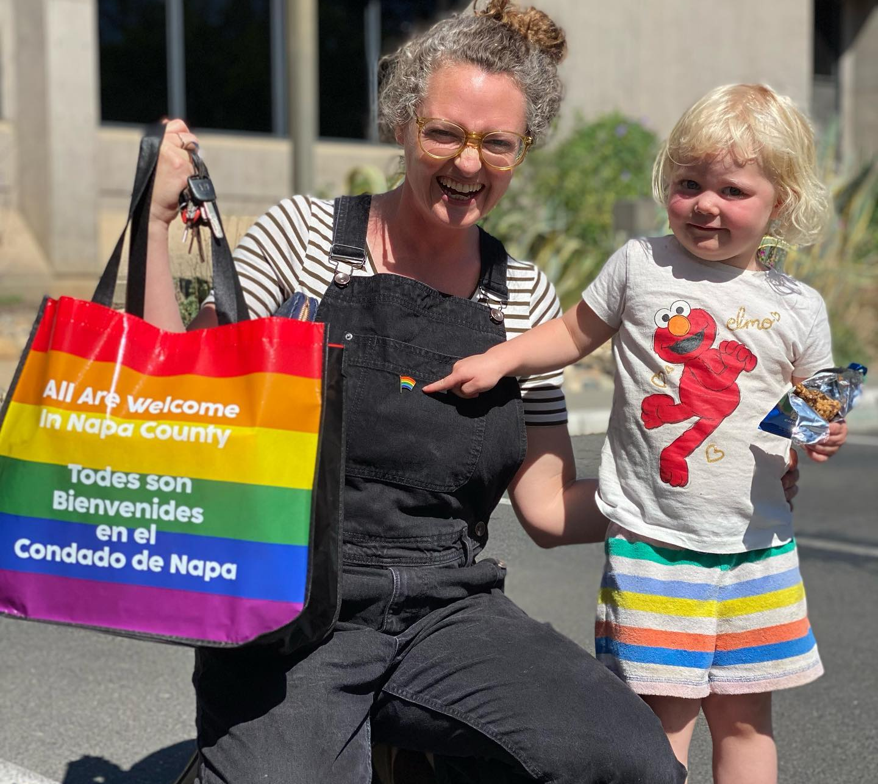
Safe Space Kit
Feedback Summary

Slide 10
LHNC LGBTQ Action Item
Increase amount and awareness of LGBTQ safe spaces in Napa County
LGBTQ Safe Space Kits
100 Safe Space Kits were developed and distributed in collaboration with Rainbow Action Network, LGBTQ Connection, and LHNC LGBTQ Action Item members in June 2022
Private sector businesses, community partners, and HHSA (CSOA, MH – MRT, SSSD, WIC) prototyped the kits.
Kit recipients were asked to complete a short 9-question feedback survey. Feedback will inform the next iteration of this CHAP project.

Slide 11
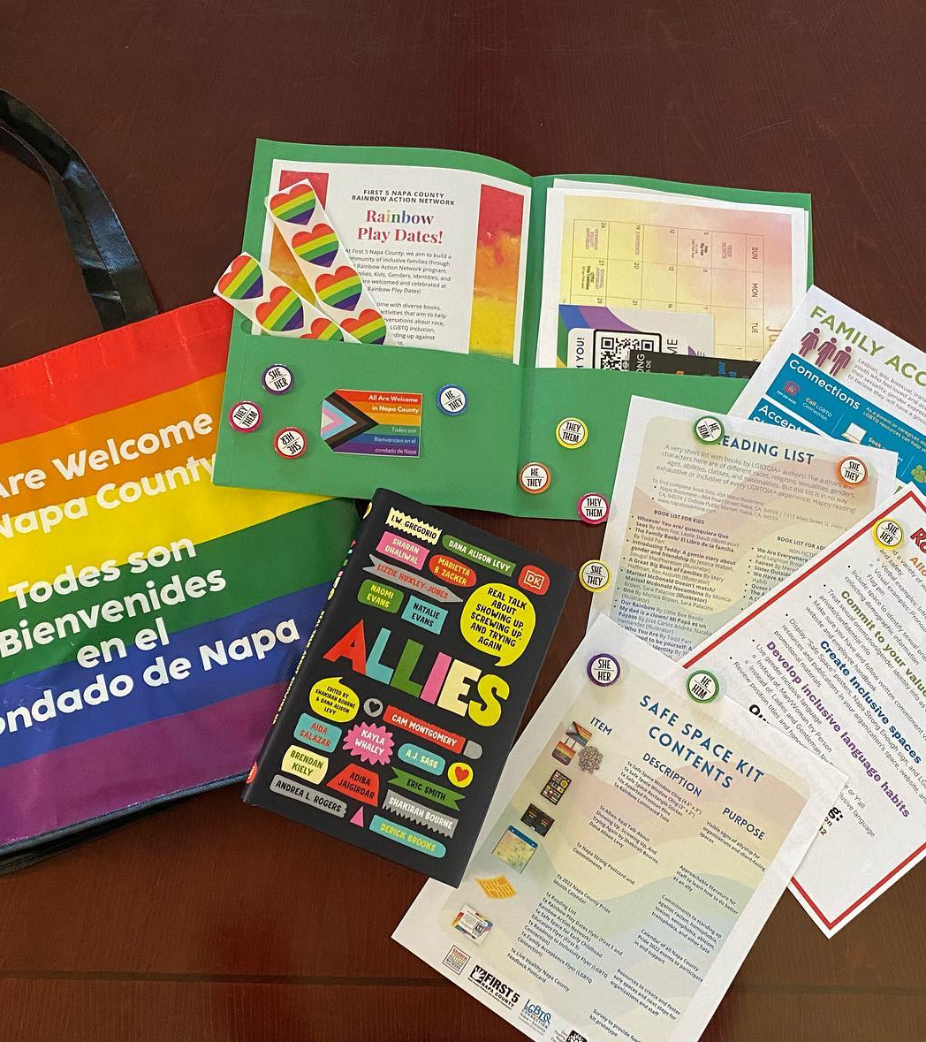
More than half of all participants that responded to survey Fully or Partially implemented All aspects of the Roadmap to Inclusivity recommendations.
Find a variety of ways (verbal, visual) to demonstrate inclusivity, respect, and safety at all times
82% Fully or Partially Implemented
Treat sexual orientation/gender identity info as other private/confidential info
86% Fully or Partially Implemented
Research and provide LGBTQ resources and publications in brochures, on websites, in ads
82% Fully or Partially Implemented
Make sure to display LGBTQ allyship on your website
73% Fully or Partially Implemented

Slide 12
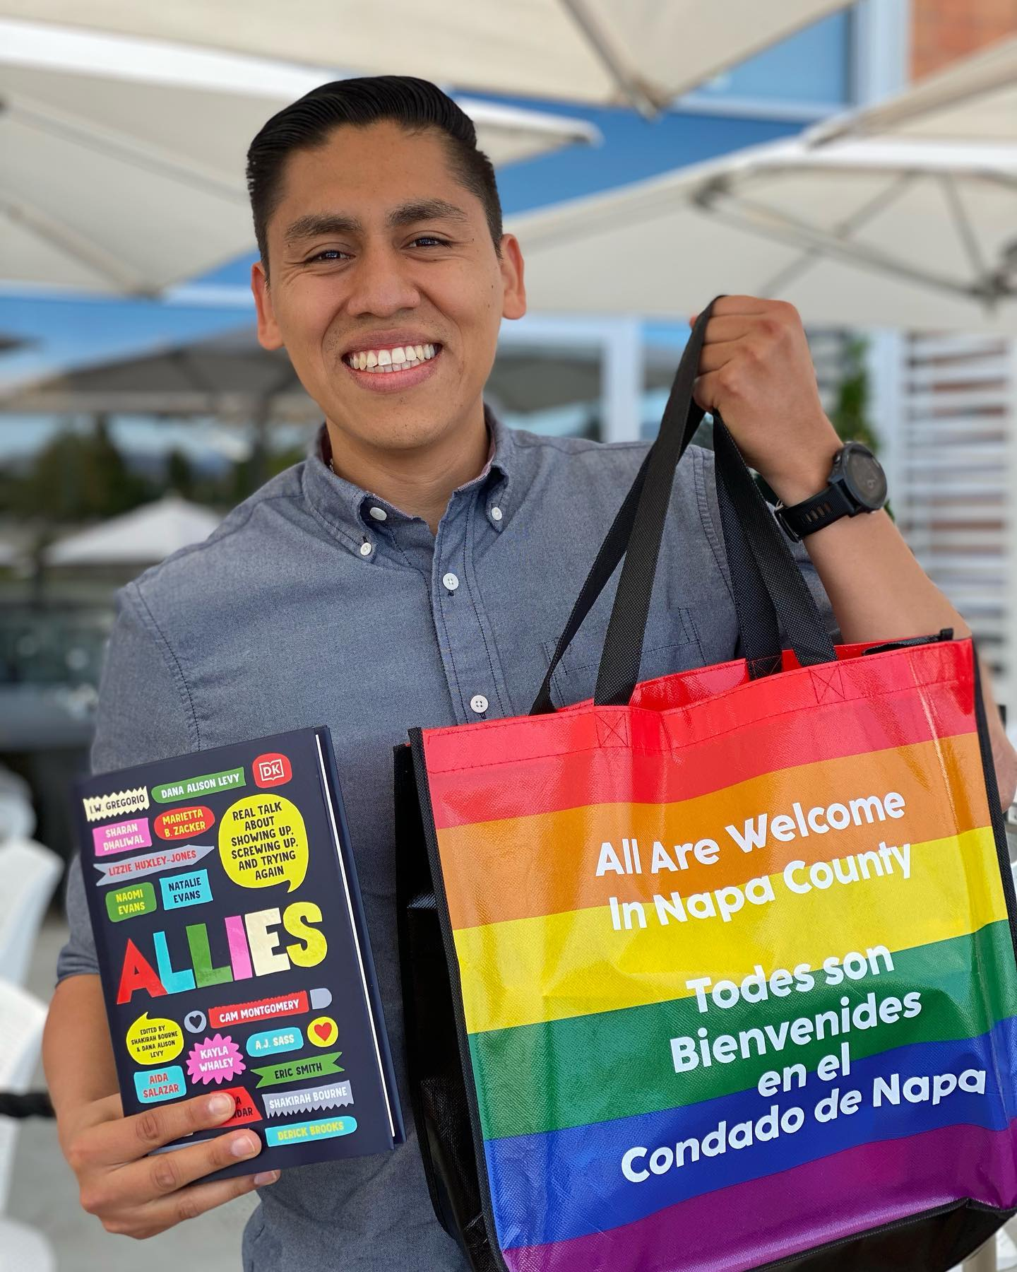
92% of participants were really satisfied or satisfied with materials
Participants found the pronoun buttons to be most useful.
Window clings, Tote bag, and LGBTQ focused resources were also well liked.

Slide 13
What material or resource did you find the most helpful?
“Having the pins and stickers are very helpful. Our teams work remotely in the school sites and travel on a daily basis. Having these tools on their backpacks and water bottles (etc) is helpful to make sure these we connect with know that the team is an open ally”
“I found that the roadmap was very helpful and the resources from local LGBTQ organizations and programs. It was great because I displayed all of the information outside my office and would often see people looking at the information which would become a segway to connecting with clients and talking more in-depth about their questions on this topic.”
All of the materials were very helpful, but the buttons and symbols of being an ally are especially helpful because they are a constant visual reminder of our mission to be fully inclusive as an agency/ staff

Slide 14
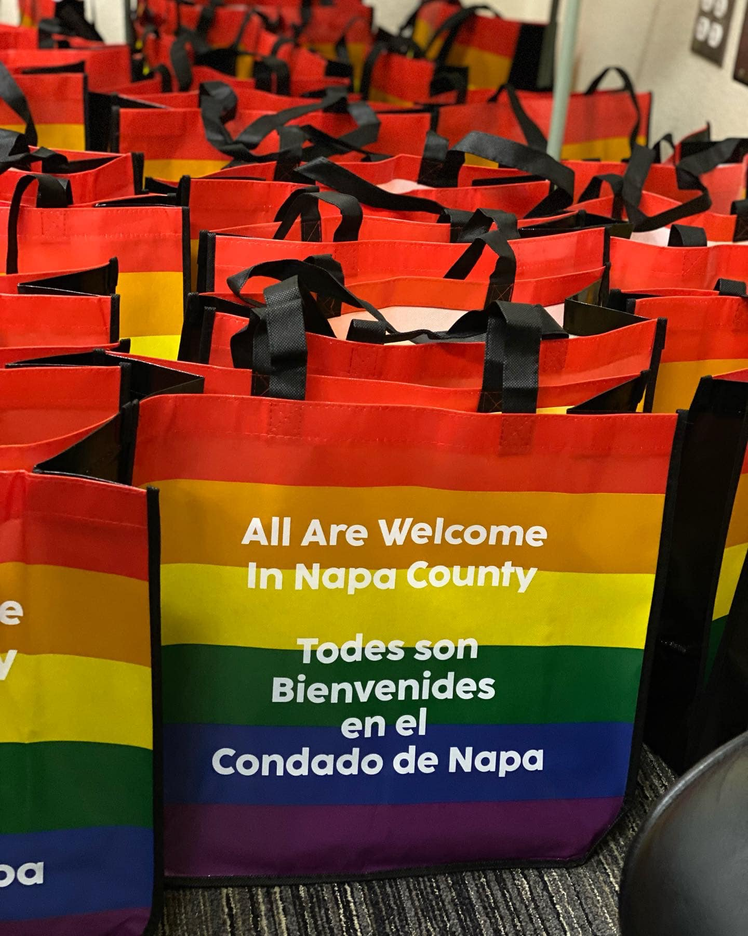
Areas to explore in future iterations
From Road Map to Inclusivity Feedback:
Include space to identify sexual orientation & gender identity when collecting demographic information
69% Fully or Partially Implemented
Consider adding samples of inclusive hiring forms:
Make sure you have and follow written commitment values on your website and employee handbook
60% Fully or Partially Implemented
Consider adding sample of handbook additions

Slide 15
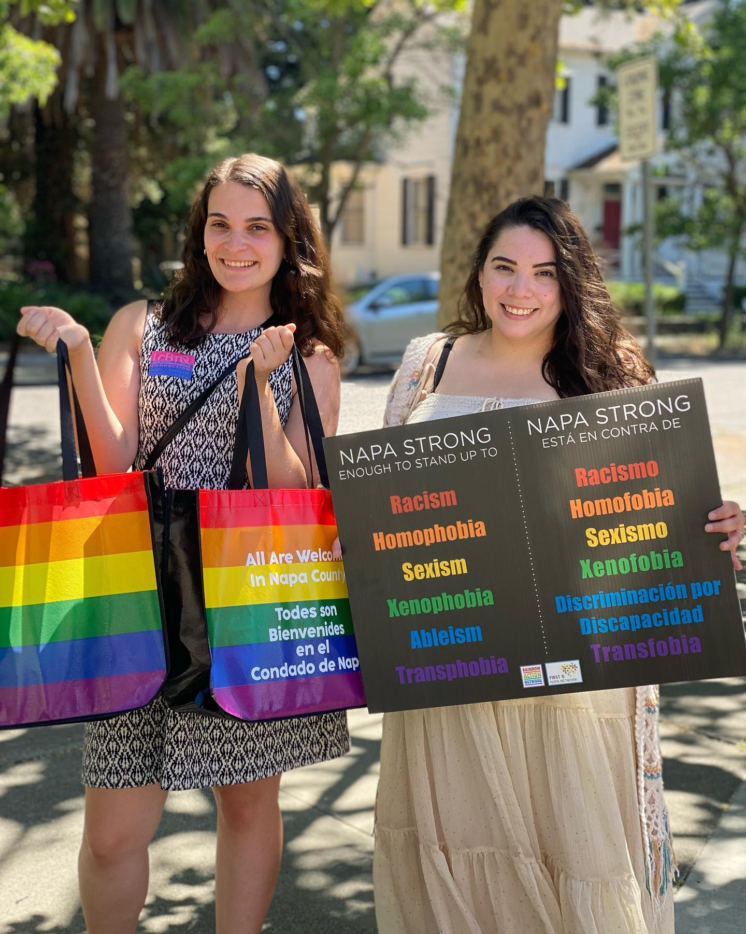
What items are missing from our Safe Space Kits?
22 responses
9 n/a or no
13 responses
Pride flags
Increased quantity of items in kit (pronoun pins) or information on where to purchase additional
Cultural materials (Latine)
Activity books/resources for clients and visitors
Pride month signage
Ongoing resources
(Could be included in LHNC Newsletter)
Pride month signs could be great. We have two different groups that we want to feel included; our staff, and also the many tourists we see every day…
Just more of this and expanding to new businesses who may or may not be on your radar.

Slide 16
Are there materials or resources you did not use? Why did you not use them?
We did not use the buttons out of concern for staff safety. There can already be very harsh feelings towards front desk teammates from rude clients, and we did not want them to feel harassed or treated unkindly by guests for their personal decision and/or gender identification. In terms of within the team we think it makes sense and creates ways to know each other better.
20 responses
6 n/a or no
13 comments
Windows clings (didn’t stick) x2
Book x3
Flyers x3
I did not use the book as much since I only have one. I would have needed to make copies of certain passages to hand out to clients if they want to read it.
I have only partially read the book.
We really liked the "Family
Acceptance/Family Rejection" flyer for our therapy and prevention work at Mentis. Some of the other flyers in the folder weren't applicable to our work at Mentis.

Slide 17
How would you like to grow as an ally?
I would like to grow as an ally to the point where my office becomes a safe space for anyone that needs help/guidance with this topic.
Our internal DEI committee is currently working on a DEI statement, which we are looking forward to sharing with our community. Our Teen Council members will all be attending an LGBTQ training with LGBTQ Connection - this is a new requirement for our leadership group. We will continue to look for ways to partner with RAN and LGBTQ Connection to learn about and promote inclusivity in Napa County <3
My growth curve is in continuing to be fluent in using the "they" pronouns in my speech. In general I continue to feel open to learning and receiving feedback about blind spots when it comes to being a business/person that feels as safe and welcoming to all as it can.

Slide 18
Next Steps
Share Staff survey
Complete purchasing for safe space kits this week
Update Roadmap to Inclusivity using youth data
Begin to ideate for youth project
Proposed next meeting date: Tuesday, May 23, at 2 pm
Notes:
$4000 available to use
Allocation of funds
Stipends for youth
Timeline of Youth Event forum
Scope/scale of project
Assess and assign resources
Tasks required for project
Date tasks need to be completed by
Projected date of event

Slide 19
¡GRACIAS por participar!
THANK YOU for participating!
LHNC@countyofnapa.org
Notes:
EN

