Slide 1
Welcome!
¡Bienvenidos!

Slide 2
Agenda
Introductions
Project Review/Last meeting recaps
Safe Space kits update
Pride Month Activities
Next steps
Notes:
For Spanish Interpretation:
In your meeting/webinar controls, click Interpretation
Click the language that you would like to hear. We will track questions in the chat and reach out with any answers that we can’t answer immediately

Slide 3
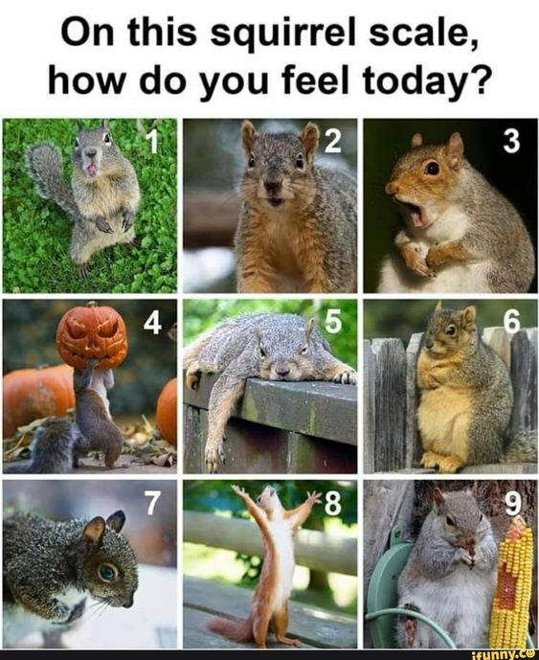
Introductions
Name and organization you are representing
On a scale of squirrel, how do you feel today?
Notes:
For Spanish Interpretation:
In your meeting/webinar controls, click Interpretation
Click the language that you would like to hear. We will track questions in the chat and reach out with any answers that we can’t answer immediately

Slide 4
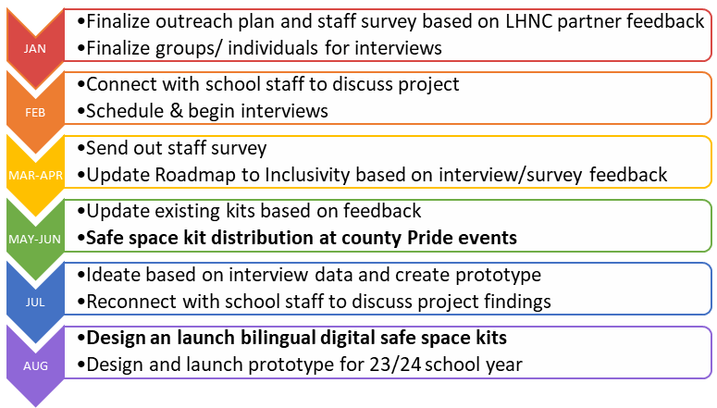
Project Review/Meeting recap
Project goal: to increase the amount and awareness of LGBTQ safe spaces in Napa County. We have wrapped our youth listening sessions and the staff survey will run through June. At our last meeting, we discussed our focus on purchasing, gathering, and translating items for the 2nd prototype of our safe space kits. We will use data from youth interviews to inform our edit of the “Roadmap to Inclusivity”.
We engaged 26 youth, grades 6-12 in group listening sessions and 1x1 interviews. We will begin ideating out youth project after our June dispersal of safe space kits.

Slide 5
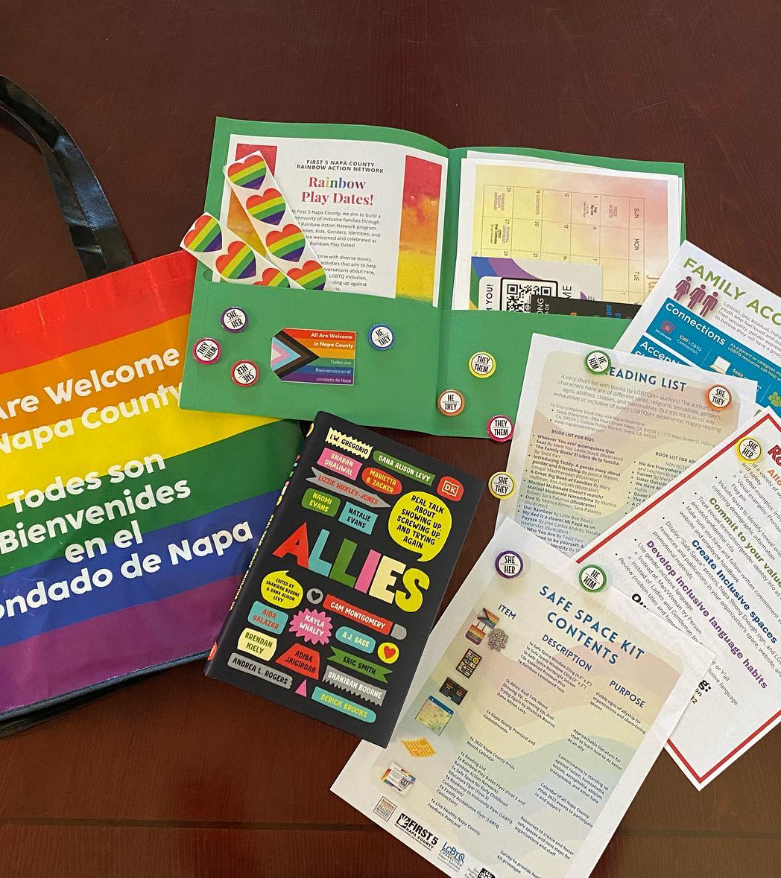
Safe Space Kit Project Update
Changes for 2nd kit prototype:
All materials will be bilingual
No book, swap for articles on allyship that we can translate
More staff facing materials including content for employee handbook recommendations, diversity statements, land acknowledgements, etc.
Coloring pages from First Five
All translated materials will be reviewed by First Five consultant for gender inclusive language.
This kit will be digital, with links to purchase physical items

Slide 6
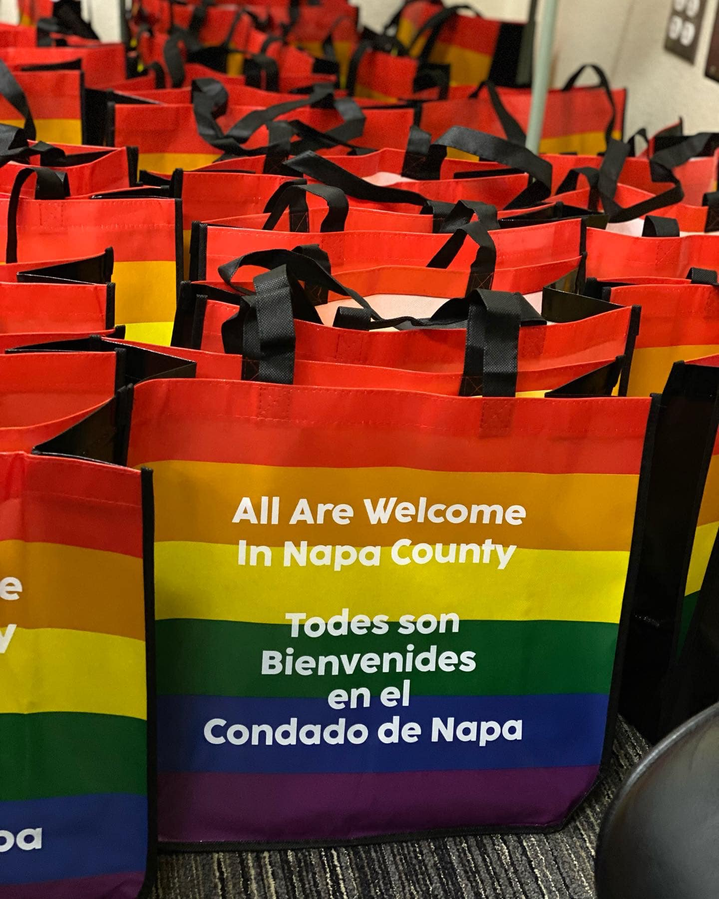
Distribution Plan:
Because the business kits will be digital, we will use existing bag supplies for outreach at county Pride events. We will be in American Canyon and have reached out to participate in Yountville. Please contact Erin with other events we can distribute at, and/or if you want to table.
We will work with the Chamber of Commerce and Hispanic Chamber of Commerce to distribute any leftover kits.

Slide 7
Next Steps
Continue to share Staff survey
Assemble safe space kits
Update Roadmap to Inclusivity using youth data
Begin to ideate for youth project
Contact Erin with Pride month tabling opportunities or tabling availability
We will convene again in July to begin the ideation phase of our youth project. Proposed meeting date: July 11, at 2 pm
Notes:
$4000 available to use
Allocation of funds
Stipends for youth
Timeline of Youth Event forum
Scope/scale of project
Assess and assign resources
Tasks required for project
Date tasks need to be completed by
Projected date of event

Slide 8
¡GRACIAS por participar!
THANK YOU for participating!
LHNC@countyofnapa.org
Notes:
EN

