Slide 1
Welcome!
¡Bienvenidos!

Slide 2
Agenda
Introductions
Project Review
Listening Session and Survey feedback
Prototype Design
Next steps
Notes:
For Spanish Interpretation:
In your meeting/webinar controls, click Interpretation
Click the language that you would like to hear. We will track questions in the chat and reach out with any answers that we can’t answer immediately

Slide 3
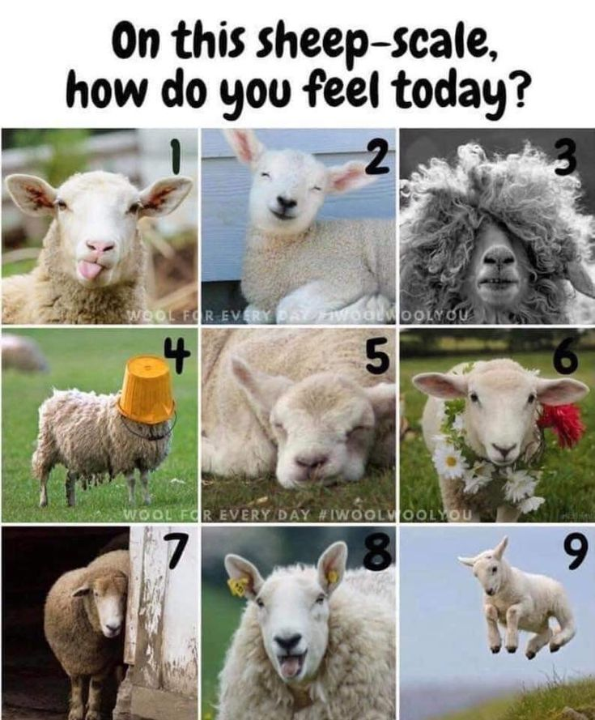
Introductions
Name and organization you are representing
Sheep check in
Notes:
For Spanish Interpretation:
In your meeting/webinar controls, click Interpretation
Click the language that you would like to hear. We will track questions in the chat and reach out with any answers that we can’t answer immediately

Slide 4
Project goal: to increase the amount and awareness of LGBTQ safe spaces in Napa County.
Since this project began, we have dispersed 200 safe space kits!
In 2022, we conducted empathic interviews with business, education, and healthcare sectors “champions” to determine what safe spaces existed in the county, and what they had in common.
This year, we engaged 26 youth, grades 6-12, in group listening sessions and 1x1 interviews to determine how they defined safe spaces. We also surveyed 32 staff who work with youth. Our next step is to review that data.
JAN
Finalize outreach plan and staff survey based on LHNC partner feedback
FEB
MAR-APR
Send out staff survey
MAY-JUN
JUL
Ideate based on interview data and create prototype
Schedule & begin interviews
Update existing kits based on feedback
AUG
Design and launch prototype for 23/24 school year
Update Roadmap to Inclusivity based on interview/survey feedback
Safe space kit distribution at county Pride events
Finalize groups/ individuals for interviews
Reconnect with students and school staff to discuss project findings
Connect with school staff to discuss project
Design and launch bilingual digital safe space kits

Slide 5
Youth Design Sprint
QUESTIONS
What do you consider to be your safe space?
Are their places on your school campus that feel safe to you? What makes them feel safe?
When you feel welcome in a space, what does that look like?
Are their places outside of school or home where you feel especially welcome or safe? How often do you visit/would like to visit? Are there barriers to accessing this space when you need it?
How might an adult show you they are creating a safe space for LGBTQ students?

Slide 6
Themes from Youth Listening Sessions
Participants feel welcome in a space when they can be vulnerable, and feel others are letting their guards down as well. They often feel welcome when people they know, or people who look like them are there. A welcoming space feels like there is room for a lot of different people to be themselves.
Participants describe “safe” adults as people who introduce their pronouns a casual and regular practice. Once students share which pronoun they prefer, “safe” adults always use those pronouns, and will correct other youth if use different ones. Teachers can show their classroom is a safe space by included LGBTQ topics as a part of every curriculum by calling out/discussing hate speech in any literature or subjects when it comes up.
Safe spaces are defined by the people in the room, rather than the physical space. While participants feel it is important to have visual safety clues (flags, posters, etc.) there is concern about the teacher in those spaces having real knowledge about LGBTQ issues and how to keep students safe. Many participants said they did not know if a teacher would tell their parents, and that was a concern.

Slide 7
Staff Survey Results
32 survey responses
Respondents are from Napa (16), American Canyon (8), Calistoga (5), and St. Helena (1). 2 respondents represent multiple cities.
Respondents work in education (14), Healthcare (7), Behavioral Health (5), and in the Non-profit sector (4)
Most respondents work with multiple ages, with the largest number of respondents (29) working with ages 13-17.
Most staff described their organizations as one that promotes allyship to LGBTQ youth, shares resources with LGBTQ youth, and shows visual safety through posters, flags, and stickers. Most responded they did not know of or said that there were no designated safe spaces or affinity groups for LGBTQ groups within their organization. Respondents were able to name most of the organizations in Napa County that provide support for LGBTQ youth, but still wanted more guidance to better support them.

Slide 8
Staff Survey Results
What are some successes you’ve had in creating safe spaces for LGBTQ youth?
Trainings from LGBTQ connections
Other Anti-bias training
Using their pronouns when they introduce themselves and using youth’s preferred pronouns
Decorating their space with visual allyship (Five respondents described their safe space as “confidential”, which felt important to their students’ trust.)
What are some barriers you’ve experienced in creating safe spaces for LGBTQ youth?
Lack or loss of funding
Other youth who are unsupportive or use negative slang in classroom environments
A lack of education for both staff and parents on how to better serve LGBTQ youth (they want to, but
just aren’t sure how)
Adults in leadership positions who are uncomfortable with making outward, intentional supportive
statements
“Small Town” stigma against LGBTQ issues and identities

Slide 9
Staff Survey Results
Is there anything else you'd like us to know about creating safe spaces for LGBTQ youth?
More training to support Spanish speaking clients, this can be a hard topic for immigrant families
As a queer educator myself I would be happy to be involved in helping plan and structure future PD events to support my peers in developing tools to help create safe spaces for LGBTQIA+ students.
Just that we would love any ideas and resources to support us in supporting our youth
What about a safe space for parents on how to deal with the emotions and feelings after their child has "come out".
I'd like some more posters for my room!
How do we get a GSA Club (or something similar) going in the high school?
I am open to learning anything that will help this group!

Slide 10
IDEATION is about generating many ideas, based on the data we just heard. Think about our feedback from students and staff. It can be helpful to think about particularly emotional statements, or areas of tension, as we work to develop some “HOW MIGHT WE” questions.
HMW- Increase school/org leadership education around these issues?
HMW- provide a space for parents of LGBTQ youth to share/learn?
HMW-support staff who want to increase safe spaces?
HMW-increase tools of inclusion (kits for schools with guidance/language/curriculum infusion?
HMW-learn how youth want to be asked about pronouns (create an FAQ for staff?)
HMW-change organizational culture (top down) so inclusion is normalized?
HMW- normalize pronoun introduction in schools?
HMW-make sure every teacher with a rainbow flag in their classroom is “safe”?
HMW-amplify the content in LGBTQ connection trainings?
HMW-
Help students who want to use different pronouns but aren’t sure how to ask?

Slide 11
HMW- make clear the link between safe spaces and health equity?
HMW- recreate the feeling of wellness centers in every classroom?
HMW-provide teachers with guidance on LGBTQ curriculum for every subject?
HMW-support parents who are struggling with their child’s identity?
HMW- make clear the link between safe spaces and health equity?
HMW- help reluctant staff to understand the implications of not providing safe space for LGBTQ students?
HMW-make visual allyship resources available to all teachers?
HMW-make Napa the leader in inclusive schools?
HMW-normalize and de-politicize this conversation?

Slide 12
Work as a team to focus on one (ok, maybe two!) “How Might We” questions
Throw a lot of ideas out there and see what sticks!
Develop a specific concept/project/item to address that “How Might We”.
Consider: our collective bandwidth and ability to get this done, project feasibility, how this solution addresses the issues that came up in our data collection, what’s the scope?
PROTOTYPING!
"Prototype as if you are right. Listen as if you are wrong"

Slide 13
Create events for school community to meet each other (with some guidance to make it easier)
HMW-support parents who are struggling with their child’s identity?
LGBTQ Connection is already working on project about parent/teacher education
Curriculum infusion for October
HMW- recreate the feeling of wellness centers in every classroom?
Curriculum infusion
Prototype wellness corner in classrooms (with feedback cycle and opportunity for scoping out)
Empower classroom leaders to set the tone
Develop a student advocate training (leadership training)
HMW- make clear the link between safe spaces and health equity?
Safe space kits based on GLSEN with local data
Ethnography with wellness center staff
Create a local LGBTQ data report

Slide 14
Next Steps
Continue our protype phase, begin purchasing plan.
Work to create bilingual digital safe space kits
Proposed next meeting date: Tuesday, August 22, at 10 am
Notes:
$4000 available to use
Allocation of funds
Stipends for youth
Timeline of Youth Event forum
Scope/scale of project
Assess and assign resources
Tasks required for project
Date tasks need to be completed by
Projected date of event

Slide 15
¡GRACIAS por participar!
THANK YOU for participating!
LHNC@countyofnapa.org
Notes:
EN

