Slide 1
Welcome!
¡Bienvenidos!

Slide 2
Agenda
Introductions
Project Review
Family Resource Center Feedback
Canvassing plan
Next Steps
Notes:
For Spanish Interpretation:
In your meeting/webinar controls, click Interpretation
Click the language that you would like to hear. We will track questions in the chat and reach out with any answers that we can’t answer immediately

Slide 3
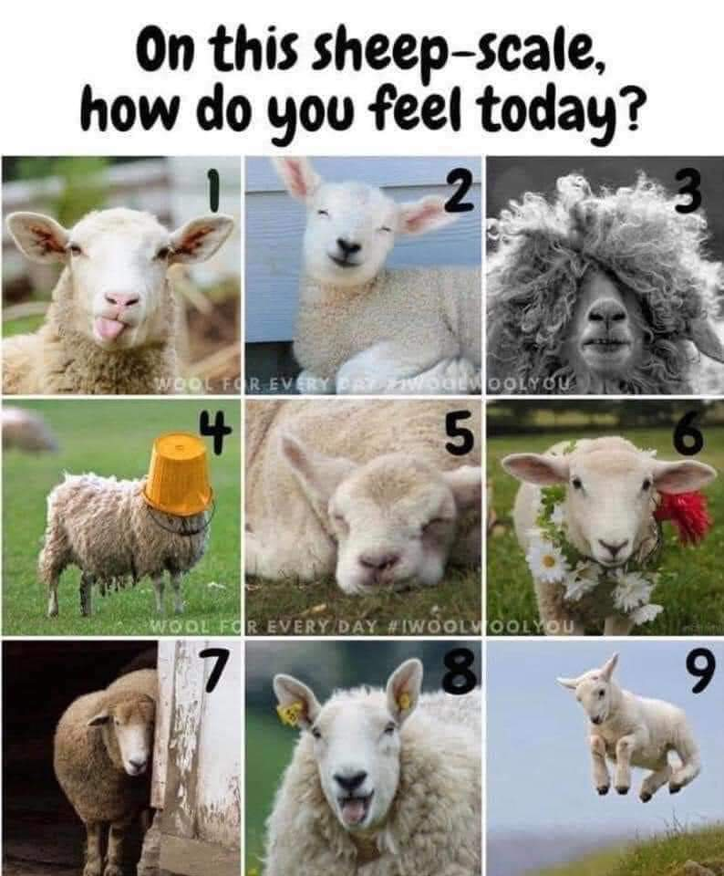
Introductions
Name and organization
On a scale of sheep, how are you feeling today?
Notes:
For Spanish Interpretation:
In your meeting/webinar controls, click Interpretation
Click the language that you would like to hear. We will track questions in the chat and reach out with any answers that we can’t answer immediately

Slide 4
LHNC Mental Wellness and Community Resiliency project
Convene Napa County Kit Makers to collect kit data, leverage knowledge, resources, distribution expertise, and build capacity.
Create a resource list that supports mental wellness and community resilience
Build off of Mentis’ existing resource list (https://mentisnapa.org/resources/)
Aim for bilingual, culturally appropriate resources that address full spectrum of mental wellness
Include information about kits available across the county.
Amplify the re-launch of Mentis’ bilingual resource database
Create bilingual flyer for distribution
Identify organizations/individuals to educate about the database, creating more opportunities for “warm handoffs”
Use data from Language inclusion group to refine flyer distribution process
Respond to mental wellness ask from Family Resource Centers
Notes:
For Spanish Interpretation:
In your meeting/webinar controls, click Interpretation
Click the language that you would like to hear. We will track questions in the chat and reach out with any answers that we can’t answer immediately

Slide 5
Family Resource Center Feedback
Nadia Barboza and Ilse Cevallos, Health Education specialists, HHSA-Public Health
Notes:
For Spanish Interpretation:
In your meeting/webinar controls, click Interpretation
Click the language that you would like to hear. We will track questions in the chat and reach out with any answers that we can’t answer immediately

Slide 6
5 Family Resource Centers were visited
31 people attended in total
Presentations include info about healthy eating, substance use (vapes), vaccine clinics, and mental health.
McPherson Elementary
Phillips Elementary
Shearer Elementary
Snow Elementary
Napa Junction Elementary
Parents would love more Mental Wellness information. They are interested in learning about ways to support their own mental health, as well as their children’s mental health. One mom described a sense of overwhelm-feeling like she is just so busy and carries the biggest load in her house. They also expressed that mental wellness is not often discussed in their culture.

Slide 7
Where do you get information?
DATA FROM LANGUAGE INCLUSION TEAM
Many times the information I receive here in the apartments [Napa Park Homes] I give to people I know or family members outside the apartments.
Online: Social Media (Facebook, YouTube, WhatsApp), Internet
Organizations: Parent University, NVUSD (Social Workers), Puertas Abiertas, CRC, Clínica Ole (Ole Health)
Places: Mercado, laundromat, apartments, Medi-Cal office (HHSA), Salvation Army
What information and/or resources would you like to have but are currently not receiving at this time?
Social services/assistance and how to access them
A central place/phone number/resource
Mental health (classes, resources, assistance for children, generational trauma)
Emergencies
Information about programs and events for children
Use Spanish in a way that I can read and understand.

Slide 8
Next Steps
FRC prototype/talk with mental health kit makers from d school
Identify areas for collaboration during May (Mental Health month)
Continue to measure impact, update google doc with flyer locations
Next meeting date: March 28, at 2 pm?
Launch canvassing plan in April, collaborate with PH team
Notes:
For Spanish Interpretation:
In your meeting/webinar controls, click Interpretation
Click the language that you would like to hear. We will track questions in the chat and reach out with any answers that we can’t answer immediately

Slide 9
¡GRACIAS por participar!
THANK YOU for participating!
LHNC@countyofnapa.org
Notes:
EN

