Slide 1
Welcome!
¡Bienvenidos!

Slide 2
Agenda
Introductions
Project Review
Family Resource Center project
Canvassing plan
Mental Health Month Collaborations
Next Steps
Notes:
For Spanish Interpretation:
In your meeting/webinar controls, click Interpretation
Click the language that you would like to hear. We will track questions in the chat and reach out with any answers that we can’t answer immediately

Slide 3
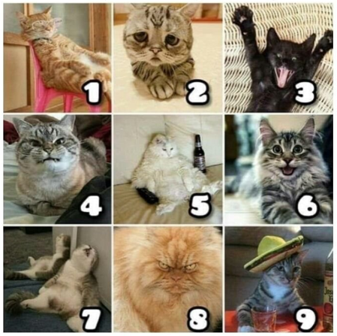
Introductions
Name and organization
On a scale of cat, how are you feeling today?
Notes:
For Spanish Interpretation:
In your meeting/webinar controls, click Interpretation
Click the language that you would like to hear. We will track questions in the chat and reach out with any answers that we can’t answer immediately

Slide 4
LHNC Mental Wellness and Community Resiliency project
Convene Napa County Kit Makers to collect kit data, leverage knowledge, resources, distribution expertise, and build capacity.
Create a resource list that supports mental wellness and community resilience
Build off of Mentis’ existing resource list (https://mentisnapa.org/resources/)
Aim for bilingual, culturally appropriate resources that address full spectrum of mental wellness
Include information about kits available across the county.
Amplify the re-launch of Mentis’ bilingual resource database
Create bilingual flyer for distribution
Identify organizations/individuals to educate about the database, creating more opportunities for “warm handoffs”
Use data from Language inclusion group to refine flyer distribution process
Respond to mental wellness ask from Family Resource Centers
Notes:
For Spanish Interpretation:
In your meeting/webinar controls, click Interpretation
Click the language that you would like to hear. We will track questions in the chat and reach out with any answers that we can’t answer immediately

Slide 5
Family Resource Center Project
Notes:
For Spanish Interpretation:
In your meeting/webinar controls, click Interpretation
Click the language that you would like to hear. We will track questions in the chat and reach out with any answers that we can’t answer immediately

Slide 6
Parents would love more Mental Wellness information. They are interested in learning about ways to support their own mental health, as well as their children’s mental health. One mom described a sense of overwhelm-feeling like she is just so busy and carries the biggest load in her house. They also expressed that mental wellness is not often discussed in their culture. We discussed developing a menu of options to bring back to FRCs for review.
We thought about offering Mental Wellness Kits, focused specifically on Spanish-speaking moms. We could work to have them ready in time for May (Mental Health Month & Mother’s Day)
We want to make sure we are enhancing the great work being done by Mentis and Aldea, and other kit makers.

Slide 7
Aldea has works with FRCs but has not provided mental wellness info directly to parents is this capacity. They are excited to learn about where we go with the project and are looking for any previous feedback about needs they’ve received from the FRCs. Mentis has been bringing mental wellness programming to Parent University for two years. This project won’t overlap with their work, and they may have materials we can use.
Kit makers were contacted to see if any of them had materials or guidance. Mentis/First 5 had a “Mindful Me” story time and made kits with some materials that we may be able to include. NCOE shared a great link to a UC Davis report about mental wellness and the Latinx community: https://health.ucdavis.edu/newsroom/pdf/latino_disparities.pdf

Slide 8
Ideas for Mental Wellness offerings (kits?)
Specific tools to manage daily mental wellness for Moms/Parents
Specific tools to manage daily mental wellness for children
Guidance on how to talk to children/family about mental wellness
Mindfulness or Meditation information
Local Mental Wellness resource information
Self care items (cozy socks, squeeze ball, candle, lavender sleep mask, plant, candy?)

Slide 9
Where do you get information?
CANVASSING PLAN
Many times the information I receive here in the apartments [Napa Park Homes] I give to people I know or family members outside the apartments.
Online: Social Media (Facebook, YouTube, WhatsApp), Internet
Organizations: Parent University, NVUSD (Social Workers), Puertas Abiertas, CRC, Clínica Ole (Ole Health)
Places: Mercado, laundromat, apartments, Medi-Cal office (HHSA), Salvation Army
Use Spanish in a way that I can read and understand.
We have a list of locations based on the Language Inclusion team’s feedback and will begin canvassing in April, so flyers are up all around for May. We will collaborate with the Public Health education specialist team and Napa Suicide Prevention Council, as they are also canvassing.
https://drive.google.com/drive/folders/1Iv-wSzcD35gtud6W2yi2D_-Y8AK7MSI2?usp=sharing

Slide 10
Mental Health Month Collaborations
Public Health has confirmed that we can create a 30 second radio spot for May.
Meeting with CAPC this week to see if we can push out the same messaging on their radio spot in May.
Any other opportunities for collaborations in May?

Slide 11
Next Steps
Bring options back to FRCs for review.
Identify areas for collaboration during May (Mental Health month)
Continue to measure impact, update google doc with flyer locations
Next meeting date: April 18, at 2 pm?
Launch canvassing plan in April
Create radio spots in English and Spanish
Create Prototype based on FRC feedback
Notes:
For Spanish Interpretation:
In your meeting/webinar controls, click Interpretation
Click the language that you would like to hear. We will track questions in the chat and reach out with any answers that we can’t answer immediately

Slide 12
¡GRACIAS por participar!
THANK YOU for participating!
LHNC@countyofnapa.org
Notes:
EN

