Slide 1
Welcome!
¡Bienvenidos!

Slide 2
Agenda
Introductions
Project Review
Family Resource Center project
Canvassing plan
Mental Health Month Collaborations
Next Steps
Notes:
For Spanish Interpretation:
In your meeting/webinar controls, click Interpretation
Click the language that you would like to hear. We will track questions in the chat and reach out with any answers that we can’t answer immediately

Slide 3
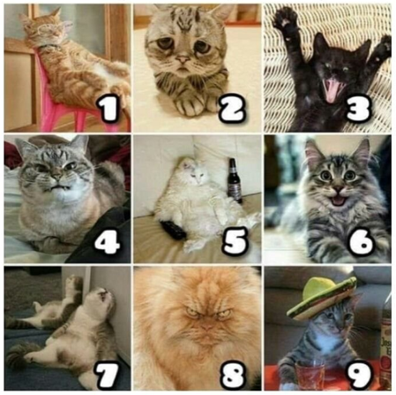
Introductions
Name and organization
On a scale of cat, how are you feeling today?
Notes:
For Spanish Interpretation:
In your meeting/webinar controls, click Interpretation
Click the language that you would like to hear. We will track questions in the chat and reach out with any answers that we can’t answer immediately

Slide 4
LHNC Mental Wellness and Community Resiliency project
Create a resource list that supports mental wellness and community resilience
Build off of Mentis’ existing resource list (https://mentisnapa.org/resources/)
Aim for bilingual, culturally appropriate resources that address full spectrum of mental wellness
Convene Napa County Kit Makers to collect kit data, leverage knowledge, resources, distribution expertise, and build capacity. Include information about kits available across the county.
Amplify the re-launch of Mentis’ bilingual resource database
Create bilingual flyer for distribution
Identify organizations/individuals to educate about the database, creating more opportunities for “warm handoffs”
Use data from Language inclusion group to refine flyer distribution process
Create Spanish Mental Wellness kits for FRC participants in time for Mother’s Day. Goal is increase access to mental wellness strategies and resources (and do something nice for moms!)
Notes:
For Spanish Interpretation:
In your meeting/webinar controls, click Interpretation
Click the language that you would like to hear. We will track questions in the chat and reach out with any answers that we can’t answer immediately

Slide 5
Family Resource Center Project
Notes:
For Spanish Interpretation:
In your meeting/webinar controls, click Interpretation
Click the language that you would like to hear. We will track questions in the chat and reach out with any answers that we can’t answer immediately

Slide 6
Sonia is presenting the idea (and possible it contents) to the parents who attend the Cafecito this morning.
We will begin purchasing this week based on their feedback.
Ideas for Mental Wellness Kits:
Specific tools to manage daily mental wellness for Moms/Parents
Specific tools to manage daily mental wellness for children
Guidance on how to talk to children/family about mental wellness
Mindfulness or Meditation information
Local Mental Wellness resource information
Self-care items (cozy socks, squeeze ball, candle, lavender sleep mask, plant, candy?)
Resource list, or link to website
Exercise or massage passes if we can get them?
Mental health book list Info about the Calm app (free for Kaiser patients)
Spanish podcast info
Tools to talk about generational trauma
Culturally-appropriate plants like marigolds, cempazuchitl
We can contact the seed library or botanical bus to see if they have plants to offer (https://napacoseedlibrary.org ) (https://thebotanicalbus.org/ )
Recipes in Spanish

Slide 7
When I need something, I go to the apartment office because I know that if they can't help me, they know where to send me.
CANVASSING PLAN
The quality of translations is important – sometimes it [the information] is translated literally, but not understandable.
Canvassing has begun!
We have created a list of locations based on the Language Inclusion team’s data, and Mentis has added to that list.
We are collaborating with Mentis, the Public Health education specialist team, NOAA and Napa Suicide Prevention Council to collectively get all of our flyers up around the county
Please contact Erin if you would like some flyers, or have a location where a flyer should be posted.
https://drive.google.com/drive/folders/1Iv-wSzcD35gtud6W2yi2D_-Y8AK7MSI2?usp=sharing
Many times the information I receive here in the apartments [Napa Park Homes] I give to people I know or family members outside the apartments.
...connections help us overcome our worries.

Slide 8
Mental Health Month Collaborations
Public Health has confirmed that we can create a 30 second radio spot for May.
CAPC has a radio spot and an article in the register that can be used- need to tie mental wellness message into parental resilience
We will meet tomorrow, at 2 pm to co-create messaging
Any other opportunities for collaborations in May?

Slide 9
Identify other areas for collaboration during May
Continue to measure impact on google doc
Continue canvassing plan
Begin purchasing for kits based on FRC feedback
Co-create messaging for May
Create radio spots in English and Spanish
Next meeting date: Tuesday, May 9, at 2 pm?
Next Steps
Notes:
For Spanish Interpretation:
In your meeting/webinar controls, click Interpretation
Click the language that you would like to hear. We will track questions in the chat and reach out with any answers that we can’t answer immediately

Slide 10
¡GRACIAS por participar!
THANK YOU for participating!
LHNC@countyofnapa.org
Notes:
EN

