Slide 1
Welcome!
¡Bienvenidos!

Slide 2
Agenda
Introductions
Project Review
Next Steps
Notes:
For Spanish Interpretation:
In your meeting/webinar controls, click Interpretation
Click the language that you would like to hear. We will track questions in the chat and reach out with any answers that we can’t answer immediately

Slide 3
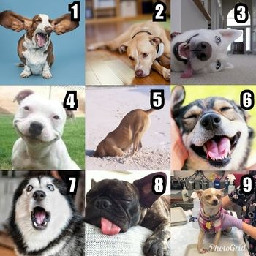
Introductions
Name and organization
On a scale of dog, how are you feeling today?
Notes:
For Spanish Interpretation:
In your meeting/webinar controls, click Interpretation
Click the language that you would like to hear. We will track questions in the chat and reach out with any answers that we can’t answer immediately

Slide 4
LHNC Mental Wellness and Community Resiliency
Project Review
Amplify the re-launch of Mentis’ bilingual resource database
Created Spanish and bilingual flyers for distribution.
Used data from Language inclusion group to refine flyer distribution process.
Partnered with Mentis staff to distribute flyers across the county.
Created a mini slide presentation about database and presented at Meetings/Family Resource Centers.
Notes:
For Spanish Interpretation:
In your meeting/webinar controls, click Interpretation
Click the language that you would like to hear. We will track questions in the chat and reach out with any answers that we can’t answer immediately

Slide 5
LHNC Mental Wellness and Community Resiliency
Project Review
Mental Wellness Campaign
Created Mental Wellness Campaign for May with a theme of Resiliency as a protective factor. Bilingual social media posts were pushed out each Monday, focusing on general resiliency, parental resiliency, youth resiliency, and community resiliency.
Public Health vaccine team let us use their May radio spots using the same messaging.
Notes:
For Spanish Interpretation:
In your meeting/webinar controls, click Interpretation
Click the language that you would like to hear. We will track questions in the chat and reach out with any answers that we can’t answer immediately

Slide 6
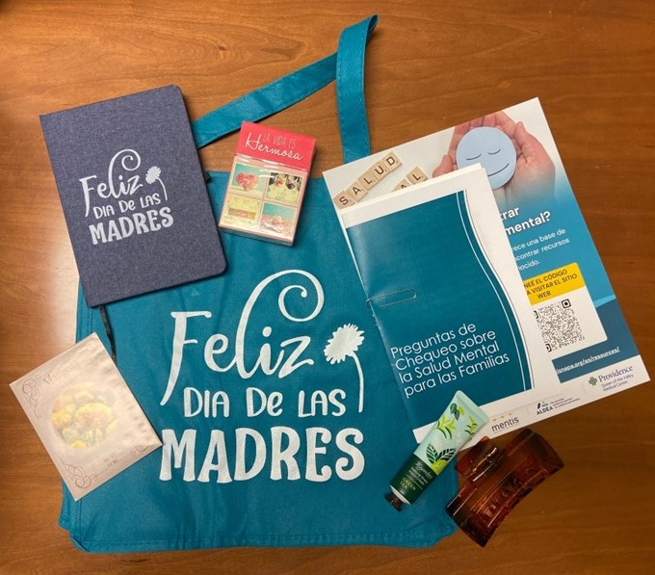
LHNC Mental Wellness and Community Resiliency Project Review
Mental Wellness Kits
Created Spanish language Mental Wellness Kits for moms at Family Resource Centers.
Kits contained: booklet with check in questions for parents to ask their children, card for moms with ideas to support their own mental health, journal, affirmation cards, hair clip, lotion, marigold seeds, Mentis flyer, and suicide prevention information from HHSA Behavioral Health
“The moms absolutely loved the wellness kits! They were super excited and happy when they received them. The especially loved the book with questions, the hair clips, and the journal.” -Maite, Parent University Site Coordinator
Notes:
For Spanish Interpretation:
In your meeting/webinar controls, click Interpretation
Click the language that you would like to hear. We will track questions in the chat and reach out with any answers that we can’t answer immediately

Slide 7
Measuring Impact
CHAP engagement tool
Link to all team materials
Next Steps

Slide 8
¡GRACIAS por participar!
THANK YOU for participating!
LHNC@countyofnapa.org
Notes:
EN

