Slide 1
Welcome!
¡Bienvenidos!

Slide 2
Agenda
Introductions
Project Overview: Youth Event Design Forum
Youth Activity Calendar
Next Steps
Notes:
For Spanish Interpretation:
In your meeting/webinar controls, click Interpretation
Click the language that you would like to hear. We will track questions in the chat and reach out with any answers that we can’t answer immediately

Slide 3
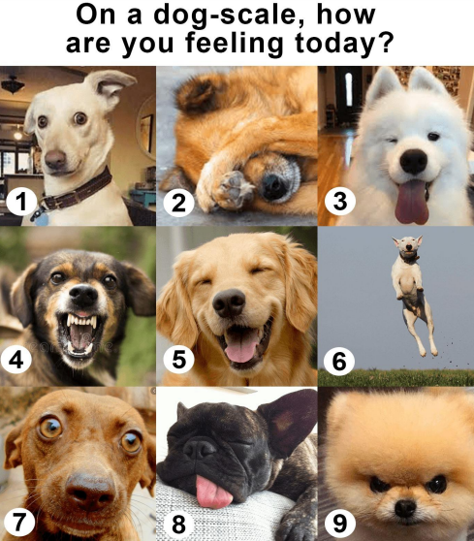
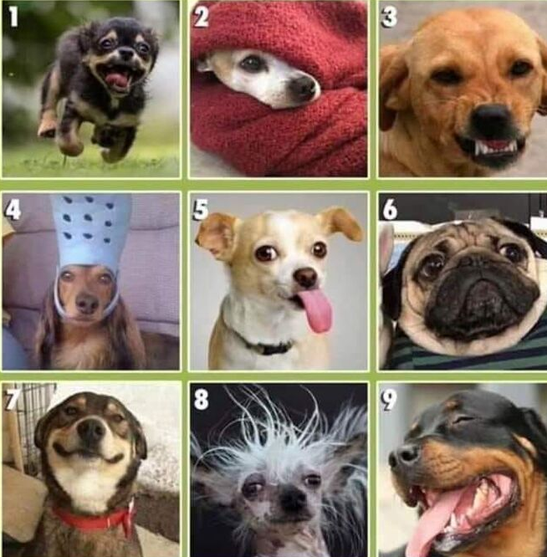
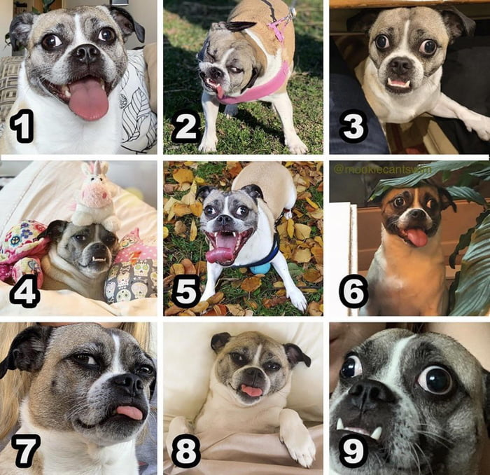
Introductions
Name and organization you are representing
On the dog scale, how are you feeling?
Notes:
For Spanish Interpretation:
In your meeting/webinar controls, click Interpretation
Click the language that you would like to hear. We will track questions in the chat and reach out with any answers that we can’t answer immediately

Slide 4
Community Health Fair – April 16th 1-3 PM
Email nadia.barboza@countyofnapa.org and ilse.gomezcevallos@countyofnapa.org
Notes:
Community Health Fair | Napa County, CA (countyofnapa.org)

Slide 5
Project Overview: Youth Event Design Forum
Convene a forum of youth to design a youth event that is responsive to their feedback. The event timeline and agenda will be co-created with youth to ensure it is accessible, attractive, and engaging for participants.
The goal of the event is to capture data based on the experience of youth in Napa County and compile this information into recommendations for the community. All youth attendees would be compensated for their time and expertise.

Slide 6
Youth Leaders
Last fall, we shared and discussed a framework to recruit and identify youth leads with a geographic focus on American Canyon. American Canyon was previously identified as a gap.
Over the last months, we developed a working group of high school youth to co-lead an event design project. We regularly convene the group after school ~ 2 a month to co-develop a project using Human-Centered design principles.

Slide 7
Ethnography from Youth
Utilizing a ‘Heartbreak’ activity to guide youth in their individual passions and how they connect with their communities, the following themes arose.
Themes that are important to youth leaders:
Friends and family
Access to recreational and community spaces
Sense of comfort and community
Helping others with college
Connection to community organizations
Access to resources - ‘ You’re not alone
Community Service – food drive, library
Outdoor Spaces – Hiking
Holding spaces for youth to feel less isolated

Slide 8
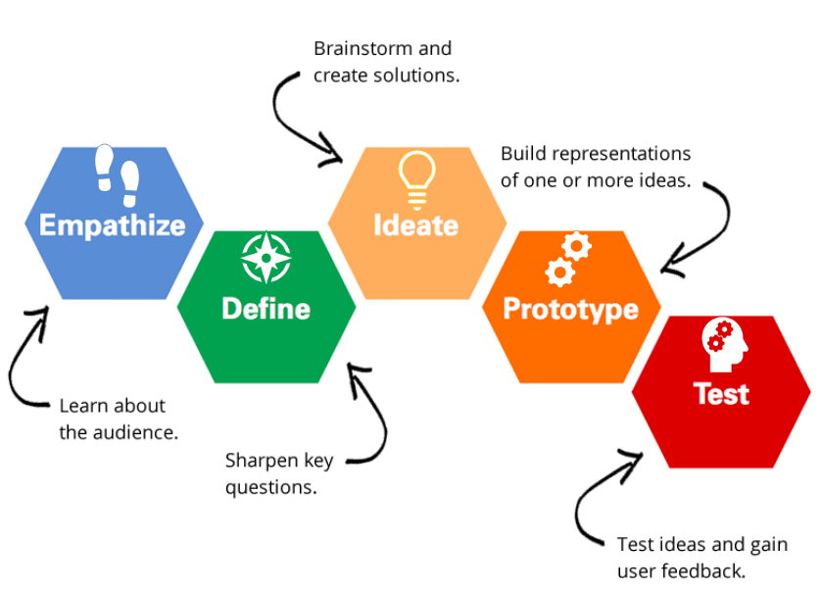
“How might we ignite the same passion we have for others?”
Notes:
$4000 available to use
Allocation of funds
Stipends for youth
Timeline of Youth Event forum
Scope/scale of project
Assess and assign resources
Tasks required for project
Date tasks need to be completed by
Projected date of event

Slide 9
Leveraging Action Team
Currently, the leaders are developing a plan to outreach and engage their peers and collect information. How can we leverage our action group to assist the youth leaders in this human-centered design sprint?
Friends and family
Access to recreational and community spaces
Sense of comfort and community
Helping others with college
Connection to community organizations
Access to resources - ‘ You’re not alone
Community Service – food drive, library
Outdoor Spaces – Hiking
Holding spaces for youth to feel less isolated

Slide 10
Youth Activity Calendar
We previously discussed supporting a social media account for youth to design and upload information about activities and events that are low/no cost, accessible, and occurring across the alcohol-drug free. Additionally, youth would be compensated for posting and designing graphics, planning and design of social media account, and managing account on a weekly basis.
Do we continue to pursue this project or pivot to attract interest from youth groups?

Slide 11
Next Steps
Identify and leverage opportunities for youth outreach
Continue convening and co-leading project with youth leads
Connect with potential partners for Youth Activity Instagram Calendar.
Next Meeting: in 1 month, 4/18 at 2 PM
Notes:
For Spanish Interpretation:
In your meeting/webinar controls, click Interpretation
Click the language that you would like to hear. We will track questions in the chat and reach out with any answers that we can’t answer immediately

Slide 12
¡GRACIAS por participar!
THANK YOU for participating!
LHNC@countyofnapa.org
Notes:
EN

